Slide 1

AI Prompting: Standard Framework and Practical Examples
Understanding effective methods and real-world applications
Notes:
---

Slide 2
Introduction to Structured AI Prompting
Notes:
---
This slide references information from the following file: https://aiatx-my.sharepoint.com/personal/damian_accountability-in-action_com/_layouts/15/Doc.aspx?sourcedoc=%7BEB453182-C4D2-4731-BBCA-2CAF206CB6F7%7D&file=AI_Opportunities_All_Groups(Sheet1).csv&action=default&mobileredirect=true
Why Standardized AI Prompting Matters

Slide 3

Why Standardized AI Prompting Matters
Importance of Clear Instructions
  AI systems require precise instructions to avoid inconsistencies and misleading outputs, ensuring reliability.
Standardized Prompting Framework
  A standardized framework defines purpose, constraints, and expected results to improve AI output quality.
Benefits in Professional Settings
  Standardized prompts support accuracy, accountability, and governance in regulated environments.
Operational Use Cases
  Real examples demonstrate how structured prompting enhances AI as a productivity assistant.
Notes:
---
This slide references information from the following file: https://aiatx-my.sharepoint.com/personal/damian_accountability-in-action_com/_layouts/15/Doc.aspx?sourcedoc=%7BEB453182-C4D2-4731-BBCA-2CAF206CB6F7%7D&file=AI_Opportunities_All_Groups(Sheet1).csv&action=default&mobileredirect=true
Artificial intelligence systems such as large language models are powerful tools, but they rely heavily on the quality of instructions they are given. Without a structured approach, AI outputs can be inconsistent, incomplete, or even misleading. Standardized AI prompting introduces discipline into human–AI interaction by ensuring that each prompt clearly defines its purpose, constraints, and expected results. This approach is especially important in professional and regulated environments, where accuracy, accountability, and clarity are critical. A standardized framework reduces the risk of hallucinations, reinforces human-in-the-loop review, and promotes repeatable success across departments. By using consistent prompt patterns, organizations can scale AI use responsibly while maintaining governance and quality control. This presentation introduces a structured AI prompting framework and demonstrates its application through real operational use cases drawn from internal business workflows. These examples illustrate how clear context-setting, task definition, and guardrails can turn AI into a reliable productivity assistant rather than a risky black box.

Slide 4
The 7-Step Prompting Framework
Notes:
---
This slide references information from the following file: https://aiatx-my.sharepoint.com/personal/damian_accountability-in-action_com/_layouts/15/Doc.aspx?sourcedoc=%7BEB453182-C4D2-4731-BBCA-2CAF206CB6F7%7D&file=AI_Opportunities_All_Groups(Sheet1).csv&action=default&mobileredirect=true
Core Components of an Effective AI Prompt

Slide 5

Core Components of an Effective AI Prompt
Establishing Context
  Clarify user identity, AI role, and task environment to set clear expectations.
2. Defining Task
Specify the exact task and provide raw inputs to avoid guesswork and errors. Be specific about document type, length, and purpose. Example: "Draft a 300-word letter to the board explaining..." rather than "Help me write something about..."
3. Provide all necessary Inputs
Supply source materials, factual details, relevant statutes, prior correspondence, or any other information ChatGPT needs.The more complete your inputs, the better the output quality.
4. Format, Style, and Guardrails
Detail exactly how the output should be structured. Include tone requirements (formal/conversational), formatting preferences (bullets/paragraphs/numbered lists), and any firm-specific style guidelines.
5. Set Clear Constraints
Identify what ChatGPT should NOT do: avoid legal conclusions, don't cite cases without verification, maintain confidentiality by not using specific names. Include word limits and deadline context.
6. Request Specific Output Elements
List exactly what should be included: executive summary, background section, analysis, recommendations, next steps, etc. This ensures comprehensive coverage of required conte.
7. Include Review Reminders
End prompts by acknowledging that output requires attorney review and verification.
Notes:
---
This slide references information from the following file: https://aiatx-my.sharepoint.com/personal/damian_accountability-in-action_com/_layouts/15/Doc.aspx?sourcedoc=%7BEB453182-C4D2-4731-BBCA-2CAF206CB6F7%7D&file=AI_Opportunities_All_Groups(Sheet1).csv&action=default&mobileredirect=true
The 7-step prompting framework provides a systematic method for creating high-quality AI prompts. The first step, establishing context, clarifies who the user is, what role the AI should assume, and the environment in which the task exists. Defining the task ensures the AI understands exactly what needs to be produced, such as a summary, checklist, or draft document. Providing inputs gives the AI the raw materials it must rely on, preventing guesswork or fabrication. Specifying format and style requirements ensures the output is usable in real workflows, whether that means tables, formal writing, or structured sections. Setting guardrails defines what the AI must not do, such as inventing facts or making legal conclusions. Requesting specific output elements ensures completeness by listing required sections or deliverables. Finally, including a review reminder reinforces the necessity of human oversight. Together, these steps transform AI from an experimental tool into a dependable operational assistant that supports professionals rather than replacing judgment.

Slide 6
Operational Use Case Examples
Notes:
---
This slide references information from the following file: https://aiatx-my.sharepoint.com/personal/damian_accountability-in-action_com/_layouts/15/Doc.aspx?sourcedoc=%7BEB453182-C4D2-4731-BBCA-2CAF206CB6F7%7D&file=AI_Opportunities_All_Groups(Sheet1).csv&action=default&mobileredirect=true
Land Use Meeting Debrief Without Recordings, Municipal Code Research and Source-Bound Summaries, Entitlement Memo Drafting from Mixed-Quality Documents, Formal Meeting Minutes from Partial Notes, Invoice Compliance and Financial QA, Contract Variation Analysis Across Prior Agreements

Slide 7

Land Use Meeting Debrief Without Recordings
Challenges Without Recordings
  Land-use meetings are complex and fast-paced, often prohibiting recordings due to confidentiality and procedural rules.
AI-Assisted Note Transformation
  AI transforms chaotic handwritten and typed notes into clear, structured summaries and actionable task lists.
Guardrails for Accuracy
  AI is constrained by guardrails to avoid inventing or assuming missing information, ensuring accuracy and trustworthiness.
Outcome Benefits
  Resulting structured summaries lead to improved follow-through, reduced confusion, and reliable references for attorneys.
  Prompt
  Role: Land-use legal ops assistant;
  Task: structure notes;
  Context: no transcript;
  Guardrails: no invention;
  Output: summary + task table
Notes:
---
This slide references information from the following file: https://aiatx-my.sharepoint.com/personal/damian_accountability-in-action_com/_layouts/15/Doc.aspx?sourcedoc=%7BEB453182-C4D2-4731-BBCA-2CAF206CB6F7%7D&file=AI_Opportunities_All_Groups(Sheet1).csv&action=default&mobileredirect=true
In land-use matters, meetings are often complex and fast-paced, yet recordings may not be allowed due to confidentiality or procedural rules. This use case demonstrates how AI can help transform chaotic handwritten or typed notes into actionable outputs. The prompt positions the AI as a land-use legal operations assistant tasked with structuring informal notes into a clear summary and task list. Guardrails explicitly prevent the AI from inventing missing information or making assumptions. By requiring a structured summary and task table, the prompt ensures that attorneys leave meetings with clarity on next steps without breaching recording restrictions. The expected outcome is improved follow-through, reduced confusion, and a reliable reference document that remains grounded in the actual notes provided. This example highlights how AI excels at organization and synthesis when given clear boundaries and responsibilities.

Slide 8

Formal Meeting Minutes from Partial Notes
AI Drafting Meeting Minutes
  AI converts sparse notes into formal, board-ready meeting minutes, easing administrative workload effectively.
Guardrails for Accuracy
  Strict safeguards prevent AI from inventing votes or procedural facts, ensuring minutes remain factually accurate.
Action Items Summary
  The prompt includes a list of action items alongside minutes, enhancing practical utility for meeting follow-up.
Efficiency and Compliance
  AI reduces drafting time while maintaining procedural compliance and administrative precision in documentation.
  Prompt
  Role: MUD minutes drafter;
  Task: draft minutes;
  Context: notes/transcript;
  Guardrails: no invented votes;
  Output: minutes + actions
Notes:
---
This slide references information from the following file: https://aiatx-my.sharepoint.com/personal/damian_accountability-in-action_com/_layouts/15/Doc.aspx?sourcedoc=%7BEB453182-C4D2-4731-BBCA-2CAF206CB6F7%7D&file=AI_Opportunities_All_Groups(Sheet1).csv&action=default&mobileredirect=true
Creating formal meeting minutes from partial notes is a common administrative burden. In this use case, AI is positioned as a minutes drafter responsible for converting sparse notes into board-ready minutes. Guardrails explicitly prevent the invention of votes or procedural facts. The prompt requires both completed minutes and a list of action items, ensuring practical utility. This approach reduces drafting time while maintaining compliance with procedural accuracy requirements. It highlights how AI can support administrative precision when prompts emphasize fidelity to source material.

Slide 9

Invoice Compliance and Financial QA
AI-Driven Invoice Review
  AI reviews invoices and spreadsheets to identify compliance issues without altering source data, ensuring data integrity.
Exact Violation Quotation
  The system quotes exact compliance violations, providing clear and actionable feedback for staff corrections.
Error Reduction and QA
  AI-assisted review reduces billing rejections and downstream errors, improving overall financial accuracy and efficiency.
  Prompt
  Role: billing compliance assistant;
  Task: flag violations;
  Context: invoice text;
  Guardrails: no edits;
  Output: violations table
Notes:
---
This slide references information from the following file: https://aiatx-my.sharepoint.com/personal/damian_accountability-in-action_com/_layouts/15/Doc.aspx?sourcedoc=%7BEB453182-C4D2-4731-BBCA-2CAF206CB6F7%7D&file=AI_Opportunities_All_Groups(Sheet1).csv&action=default&mobileredirect=true
Financial operations often depend on early-stage spreadsheets and invoices that have not yet entered formal accounting systems. This example demonstrates how AI can act as a quality assurance assistant, reviewing invoice text or spreadsheets to flag compliance issues without making edits. The prompt mandates quotation of exact violations and prohibits any changes to source data. The expected outcome is a clear list of issues that can be reviewed and corrected by staff, reducing billing rejections and downstream errors. This use case underscores AI’s strength in validation and review tasks when paired with conservative constraints.

Slide 10
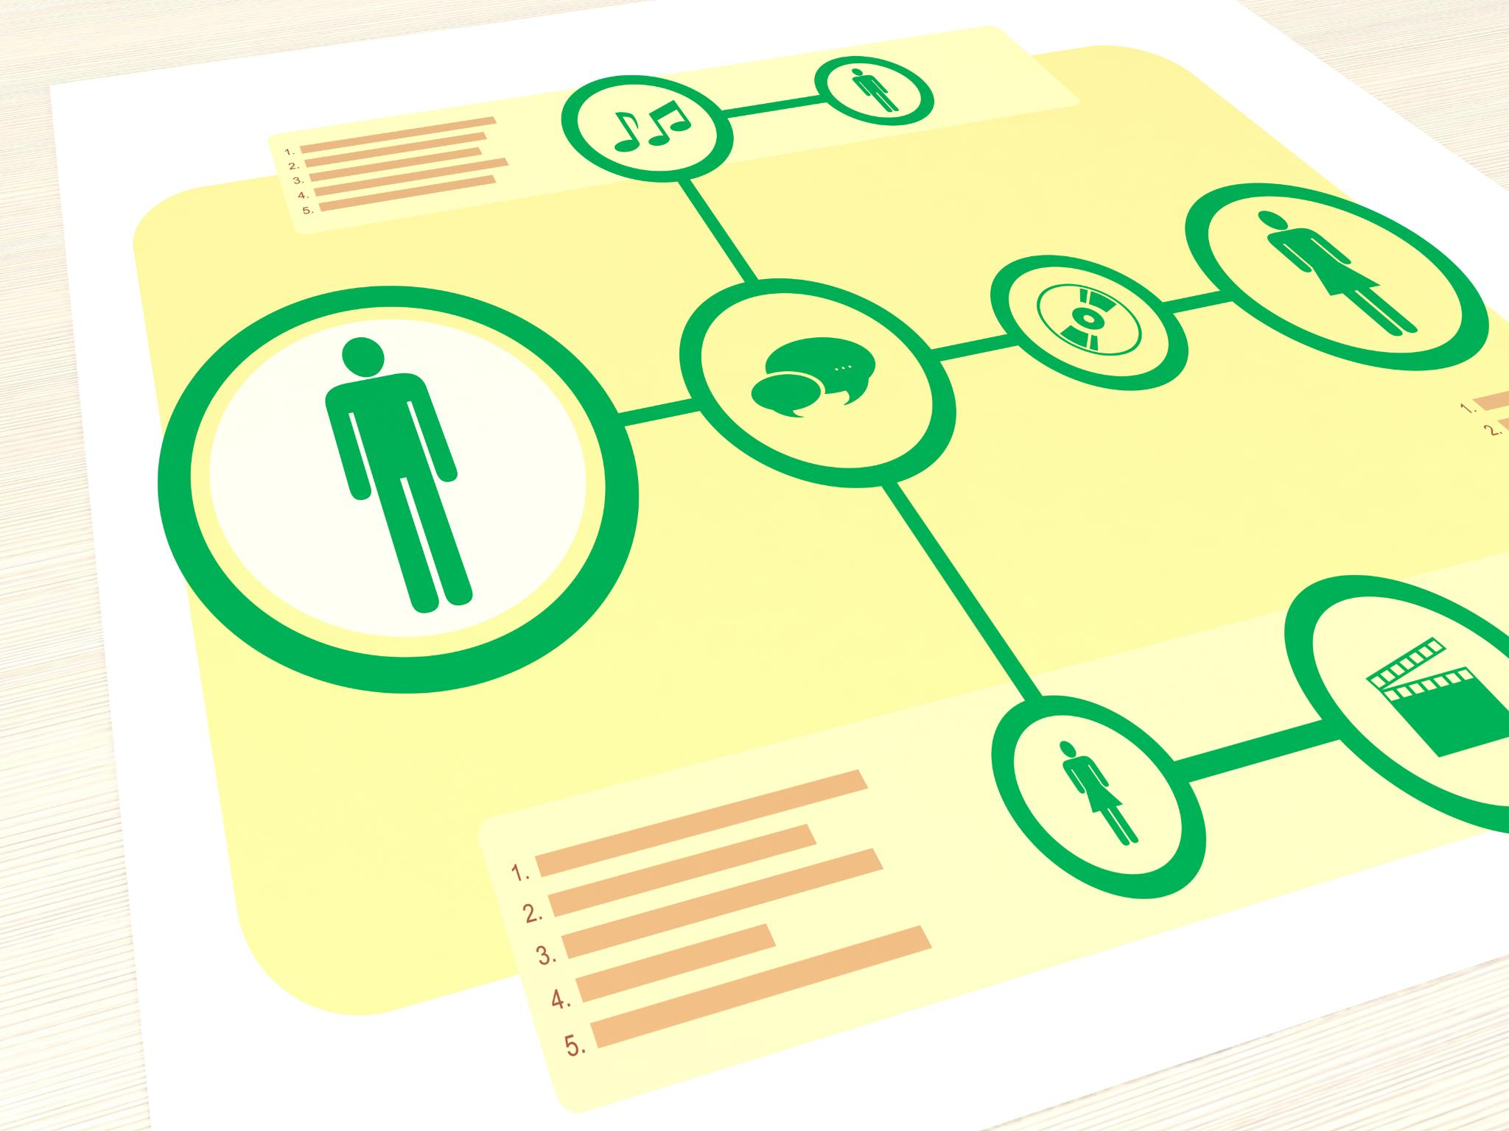
Contract Variation Analysis Across Prior Agreements
Labor-Intensive Comparison
  Analyzing contract variations manually is time-consuming and complex, requiring detailed attention to language and structure.
AI-Driven Neutral Comparison
  AI compares agreements neutrally, producing variation tables without interpretation or ranking, facilitating objective analysis.
Human Legal Judgment
  Guardrails ensure AI only compares, leaving legal decisions to human attorneys to maintain responsibility and accuracy.
Efficient Pattern Detection
  AI efficiently surfaces patterns and differences to speed up precedent evaluation and contract review processes.
  Prompt
  Role: contract analysis assistant;
  Task: compare contracts;
  Context: past agreements;
  Guardrails: no ranking;
  Output: variation table
Notes:
---
This slide references information from the following file: https://aiatx-my.sharepoint.com/personal/damian_accountability-in-action_com/_layouts/15/Doc.aspx?sourcedoc=%7BEB453182-C4D2-4731-BBCA-2CAF206CB6F7%7D&file=AI_Opportunities_All_Groups(Sheet1).csv&action=default&mobileredirect=true
Analyzing variations across multiple prior contracts is essential for precedent evaluation but can be labor-intensive. In this scenario, the AI is instructed to compare agreements and output a neutral variation table without ranking or interpretation. Guardrails ensure the AI performs comparison only, leaving legal judgment to humans. The resulting analysis enables attorneys to quickly identify differences in language, structure, or clauses across documents. This example illustrates how AI can efficiently surface patterns and differences while respecting the boundary between analysis and legal decision-making.

Slide 11

City Code Research
Efficient Municipal Code Research
  AI accelerates research by summarizing only user-provided municipal code sections with mandatory citations.
Strict Source Boundaries
  The prompt enforces strict boundaries to prevent external or outdated references during research.
Standardized Output Format
  Research outputs are standardized in table format for faster comparison and review by practitioners.
Enhancing Legal Efficiency
  This tool boosts research efficiency and consistency, enabling focus on analysis and strategy.
  Prompt
  Role:
  land-use researcher;
  Task: identify code sections;
  Context: provided codes only;
  Guardrails: cite sections;
  Output: table
Notes:
Municipal code research is time-intensive and prone to inconsistency when done manually. This AI use case accelerates research by summarizing only the code sections explicitly provided by the user, with mandatory citation of each referenced section. The prompt enforces strict source boundaries, eliminating the risk of external or outdated references. By standardizing outputs into a table format, it supports faster comparison and review. This tool does not replace legal interpretation; instead, it increases efficiency and consistency in preliminary research, allowing practitioners to focus on analysis and strategy rather than manual lookup.

Slide 12

Entitlement Memo Builder
Document Synthesis Support
  The AI tool synthesizes multiple documents, including scanned materials of varying quality, to draft entitlement memos efficiently.
Data Quality Transparency
  Unreadable sections and missing information are explicitly flagged, ensuring transparency without content inference.
Time Efficiency and Accuracy
  The system shortens drafting time while maintaining accuracy and professional responsibility by using a strict template.
Improved Collaboration
  Clear identification of gaps enables focused follow-up and enhances collaboration between analysts and decision-makers.
  Prompt
  Role: land-use analyst;
  Task: draft memo;
  Context: mixed-quality docs;
  Guardrails: flag unreadable;
  Output: memo + missing items
Notes:
Entitlement memos often require synthesis of numerous documents, including scanned materials of varying quality. This AI use case supports analysts by drafting a first-pass memo while explicitly flagging unreadable sections or missing information. The system follows a predefined template and is prohibited from inferring content, ensuring transparency about data quality. This approach shortens drafting time while preserving accuracy and professional responsibility. By clearly identifying gaps, it enables focused follow-up and improves collaboration between staff and decision-makers.

Slide 13

Application Pre-Fill
Automated Form Pre-Filling
  AI automates pre-filling of structured municipal applications while maintaining labels and formatting.
Explicit Missing Data Marking
  Missing information is clearly marked as 'TBD' to prevent silent omissions or assumptions.
Review Checklist Support
  Output includes a review checklist to ensure accuracy and regulatory compliance.
Reduced Clerical Burden
  AI streamlines administrative workloads without compromising regulatory precision.
  Prompt
  Role: land-use admin;
  Task: pre-fill form;
  Context: form + facts;
  Guardrails: use TBD;
  Output: filled form + checklist
Notes:
Municipal applications are often repetitive and rigidly structured. This AI use case automates the pre-filling of such forms using provided facts while preserving labels, order, and formatting. Missing information is explicitly marked as 'TBD', preventing silent omissions or assumptions. The output includes both a completed draft and a review checklist, supporting accuracy and compliance. This tool reduces clerical burden without compromising regulatory precision, illustrating how AI can safely streamline administrative workloads.

Slide 14


Minutes Template Mapper
Handling Sparse Notes
  Maps unstructured notes into official templates using placeholders to indicate missing information clearly.
Maintaining Accuracy
  AI avoids interpreting missing data, preserving gaps to ensure transparency and compliance with standards.
Improving Efficiency
  Speeds up meeting minutes preparation while adhering to formatting requirements and preserving essential details.
  Prompt
  Role: document structurer;
  Task: map notes;
  Context: sparse notes;
  Guardrails: placeholders only;
  Output: completed template
Notes:
When notes are sparse or unstructured, aligning them with an official minutes template can be difficult. This use case maps existing notes into the required format using placeholders where information is missing. The AI performs no interpretation, ensuring that gaps remain visible. This supports compliance with formatting standards and speeds up preparation while preserving accuracy.

Slide 15
Next Agenda Generator
Automated Agenda Creation
  AI generates draft agendas by reviewing unresolved items from prior meeting minutes,reducing manual effort.
Governance and Fairness
  The prompt blocks new agenda items to maintain governance rules and procedural fairnessduring meetings.
Streamlined Meeting Preparation
  Outputting both agenda and carry-forward list reduces administrative burden and speeds upmeeting readiness.
Focused Board Discussions
  Reliable agenda creation keeps boards focused on pending business and improves meetingproductivity.
  Prompt
  Role: meeting coordinator;
  Task: draft agenda;
  Context: prior minutes;
  Guardrails: unresolved only;
  Output: agenda + carry-forward
Notes:
When notes are sparse or unstructured, aligning them with an official minutes template can be difficult. This use case maps existing notes into the required format using placeholders where information is missing. The AI performs no interpretation, ensuring that gaps remain visible. This supports compliance with formatting standards and speeds up preparation while preserving accuracy.

Slide 16
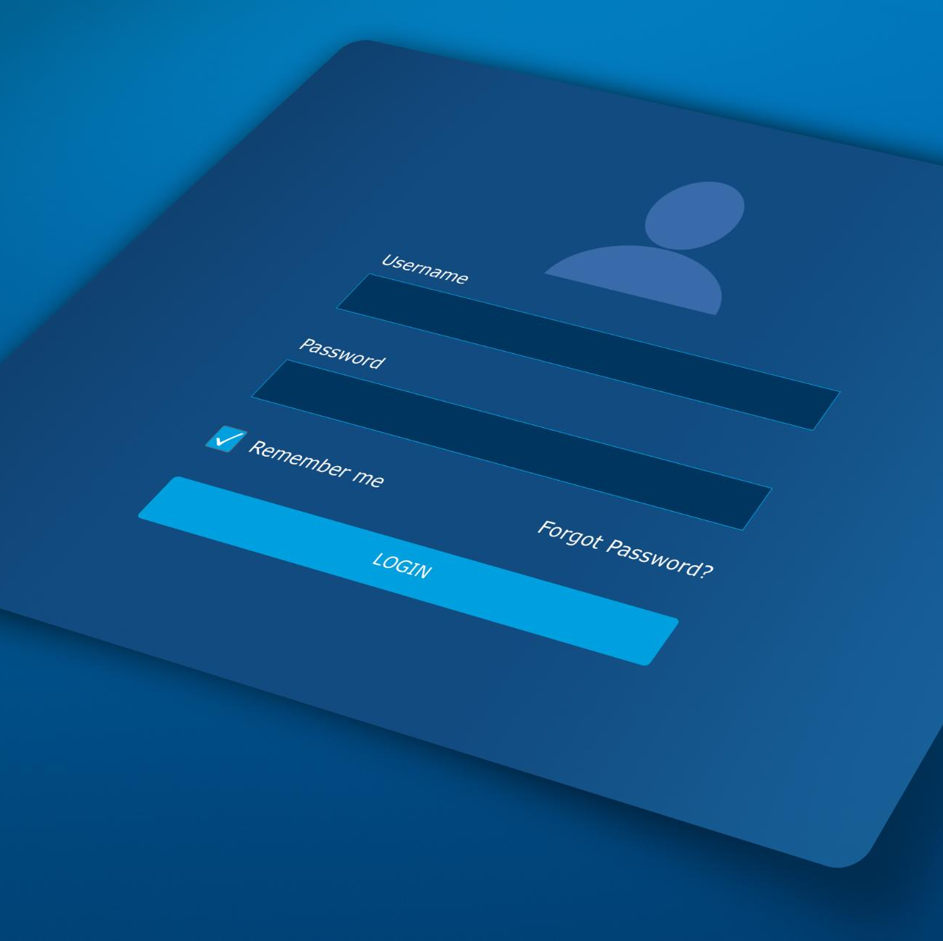
Covenant Demand Letter Draft
AI-Generated Demand Draft
AI creates initial demand letters based strictly on covenant text and facts, enhancing accuracy.
Legal Defensibility Ensured
The system prohibits inventing violations, maintaining the legal integrity of the demand letters.
Efficiency Through Review
Provides 80% complete drafts that highlight gaps, allowing legal staff to focus on review and customization.
Consistent Enforcement Communication
This process enables faster turnaround and more consistent enforcement demand communications.
Prompt
Role: meeting coordinator;
Task: draft agenda;
Context: prior minutes;
Guardrails: unresolved only;
Output: agenda + carry-forward
Notes:
Municipal applications are often repetitive and rigidly structured. This AI use case automates the pre-filling of such forms using provided facts while preserving labels, order, and formatting. Missing information is explicitly marked as 'TBD', preventing silent omissions or assumptions. The output includes both a completed draft and a review checklist, supporting accuracy and compliance. This tool reduces clerical burden without compromising regulatory precision, illustrating how AI can safely streamline administrative workloads.

Slide 17

Repetitive covenant demand letters
Operational Challenges
  Manual drafting causes rework, inconsistency, and risks overstating violations across properties.
AI Drafting Assistant
  AI produces 80% complete demand letter drafts, enabling legal staff to focus on review and strategy.
Governance and Accuracy
  AI must avoid fabricating facts, highlight missing information, and base drafts on verified records.
Outcomes and Benefits
  Faster letter turnaround, consistent communication, and improved internal quality control are expected.
  Prompt
  Role: legal drafting assistant;
  Task: draft demand letter;
  Context: covenant text;
  Guardrails: no invented facts;
  Output: draft + gaps
Notes:
---
This slide references information from the following file: https://aiatx-my.sharepoint.com/:p:/g/personal/damian_accountability-in-action_com/IQBsKLRm0Yl-SoRu143WK4CjAXzgQL9c1BecH9TW84RyonY,https://aiatx-my.sharepoint.com/personal/damian_accountability-in-action_com/_layouts/15/Doc.aspx?sourcedoc=%7B1063764D-44A6-44D1-9CBE-723F6835F080%7D&file=AI_Operational_Use_Cases_From_CSV%201.pptx&action=edit&mobileredirect=true,https://aiatx-my.sharepoint.com/personal/damian_accountability-in-action_com/_layouts/15/Doc.aspx?sourcedoc=%7B1DF167FD-F484-47CD-A811-CE8B24109AD1%7D&file=AB%20Austin_Prompt_Library.pptx&action=edit&mobileredirect=true&DefaultItemOpen=1
This slide addresses the recurring operational burden of producing covenant demand letters when the same enforcement patterns appear across multiple properties or violations. The core challenge is that demand letters must be consistent, defensible, and anchored to the exact covenant language and the verified facts of the situation; however, manual drafting often leads to needless rework, stylistic drift across attorneys or staff, and a higher risk of accidentally overstating a violation. The proposed AI use case is a “Covenant Demand Letter Draft” assistant that produces an approximately 80% complete first draft, allowing legal staff to focus on review, tailoring, and strategic judgment rather than repetitive formatting and boilerplate composition. The workflow is intentionally structured: the AI is assigned a legal drafting assistant role, the task is explicitly defined as drafting a demand letter, and the required inputs include the covenant text and the factual record for the specific property. Governance and accuracy guardrails are central to this use case: the AI must not invent facts, must avoid asserting violations not supported by the provided record, and should explicitly call out “gaps” where information is missing (for example, the date of the violation, the cure period specified in the covenant, or prior notice history). The expected operational outcome is faster turnaround and more consistent enforcement communications, with the added benefit of improved internal quality control because the AI can highlight missing items for humans to fill. The prompt block reinforces disciplined prompting by specifying role, task, context, guardrails, and output expectations—mirroring the standardized prompting framework and the operational slide format shown in the reference deck. In practice, teams should treat the AI output as a draft that requires attorney verification, especially around remedy language, timelines, and any jurisdiction-specific requirements. By explicitly binding the AI to provided facts only, this use case leverages AI’s strength—rapid organization and coherent drafting—while keeping legal reasoning, enforcement discretion, and final accountability with human professionals.

Slide 18

PIA requests rely on keyword search
Keyword Search Limitations
  Ad hoc keyword searches miss relevant documents due to term variations and inconsistent naming conventions.
AI-Powered Search Planning
  AI designs comprehensive search strategies with synonyms, Boolean patterns, and search location checklists.
Human-in-the-Loop Governance
  Humans execute searches and apply legal review while AI provides structured, auditable search plans.
Improved Compliance Outcomes
  Systematic search approach leads to better document recall, fewer iterations, and defensible compliance.
  Prompt
  Role: Document retrieval assistant
  Objective: Design a precise search query plan
  Context: Processing a PIA (Public Information Access) request
  Constraints: Do not claim access to internal or restricted systems
  Output: Clear, step‑by‑step query plan
Notes:
---
This slide references information from the following file: https://aiatx-my.sharepoint.com/:p:/g/personal/damian_accountability-in-action_com/IQBsKLRm0Yl-SoRu143WK4CjAXzgQL9c1BecH9TW84RyonY,https://aiatx-my.sharepoint.com/personal/damian_accountability-in-action_com/_layouts/15/Doc.aspx?sourcedoc=%7B1063764D-44A6-44D1-9CBE-723F6835F080%7D&file=AI_Operational_Use_Cases_From_CSV%201.pptx&action=edit&mobileredirect=true,https://aiatx-my.sharepoint.com/personal/damian_accountability-in-action_com/_layouts/15/Doc.aspx?sourcedoc=%7B1DF167FD-F484-47CD-A811-CE8B24109AD1%7D&file=AB%20Austin_Prompt_Library.pptx&action=edit&mobileredirect=true&DefaultItemOpen=1
This slide focuses on the inefficiency and incompleteness that occur when Public Information Act (PIA) requests are handled through ad hoc keyword searches. The underlying problem is that staff frequently rely on a narrow set of terms, which can miss relevant documents due to variations in naming conventions, abbreviations, file structures, or the way internal teams describe the same concept. That missed recall increases downstream risk: incomplete production, expensive follow-up searches, and delays that create compliance pressure. The AI use case proposed here is a “PIA Search Planner,” positioned explicitly as a document retrieval assistant whose job is not to access systems or retrieve records directly, but to design a comprehensive search strategy that humans can execute in approved repositories. The slide’s logic emphasizes the difference between planning and execution: AI can rapidly expand the query space and propose structured search paths (synonyms, related entities, date ranges, custodians, and file-type considerations) while guardrails prevent it from claiming system access or guaranteeing completeness. The prompt should provide the PIA request language, relevant organizational context (departments likely involved, known project names, prior responsive productions), and any constraints such as time periods or specific custodians. The assistant then outputs a query plan with candidate keywords, Boolean patterns, alternative spellings, and a checklist of places to search (email, shared drives, case folders, contract repositories), along with rationale for why each term or location matters. Expected outcomes include improved document recall, fewer iterations, and a more defensible process because the organization can demonstrate a systematic and repeatable approach to search. Operationally, this improves staff efficiency by turning an unstructured “hunt” into an auditable plan. Governance is maintained by keeping humans in the loop: staff still run the searches, review responsiveness, and apply legal exemptions; AI simply provides the blueprint. This structure mirrors the standardized prompting style in the reference presentation—explicit role definition, constrained claims, and output formatting—so the result is a usable, conservative tool that supports compliance without introducing overconfidence or automation promises.

Slide 19
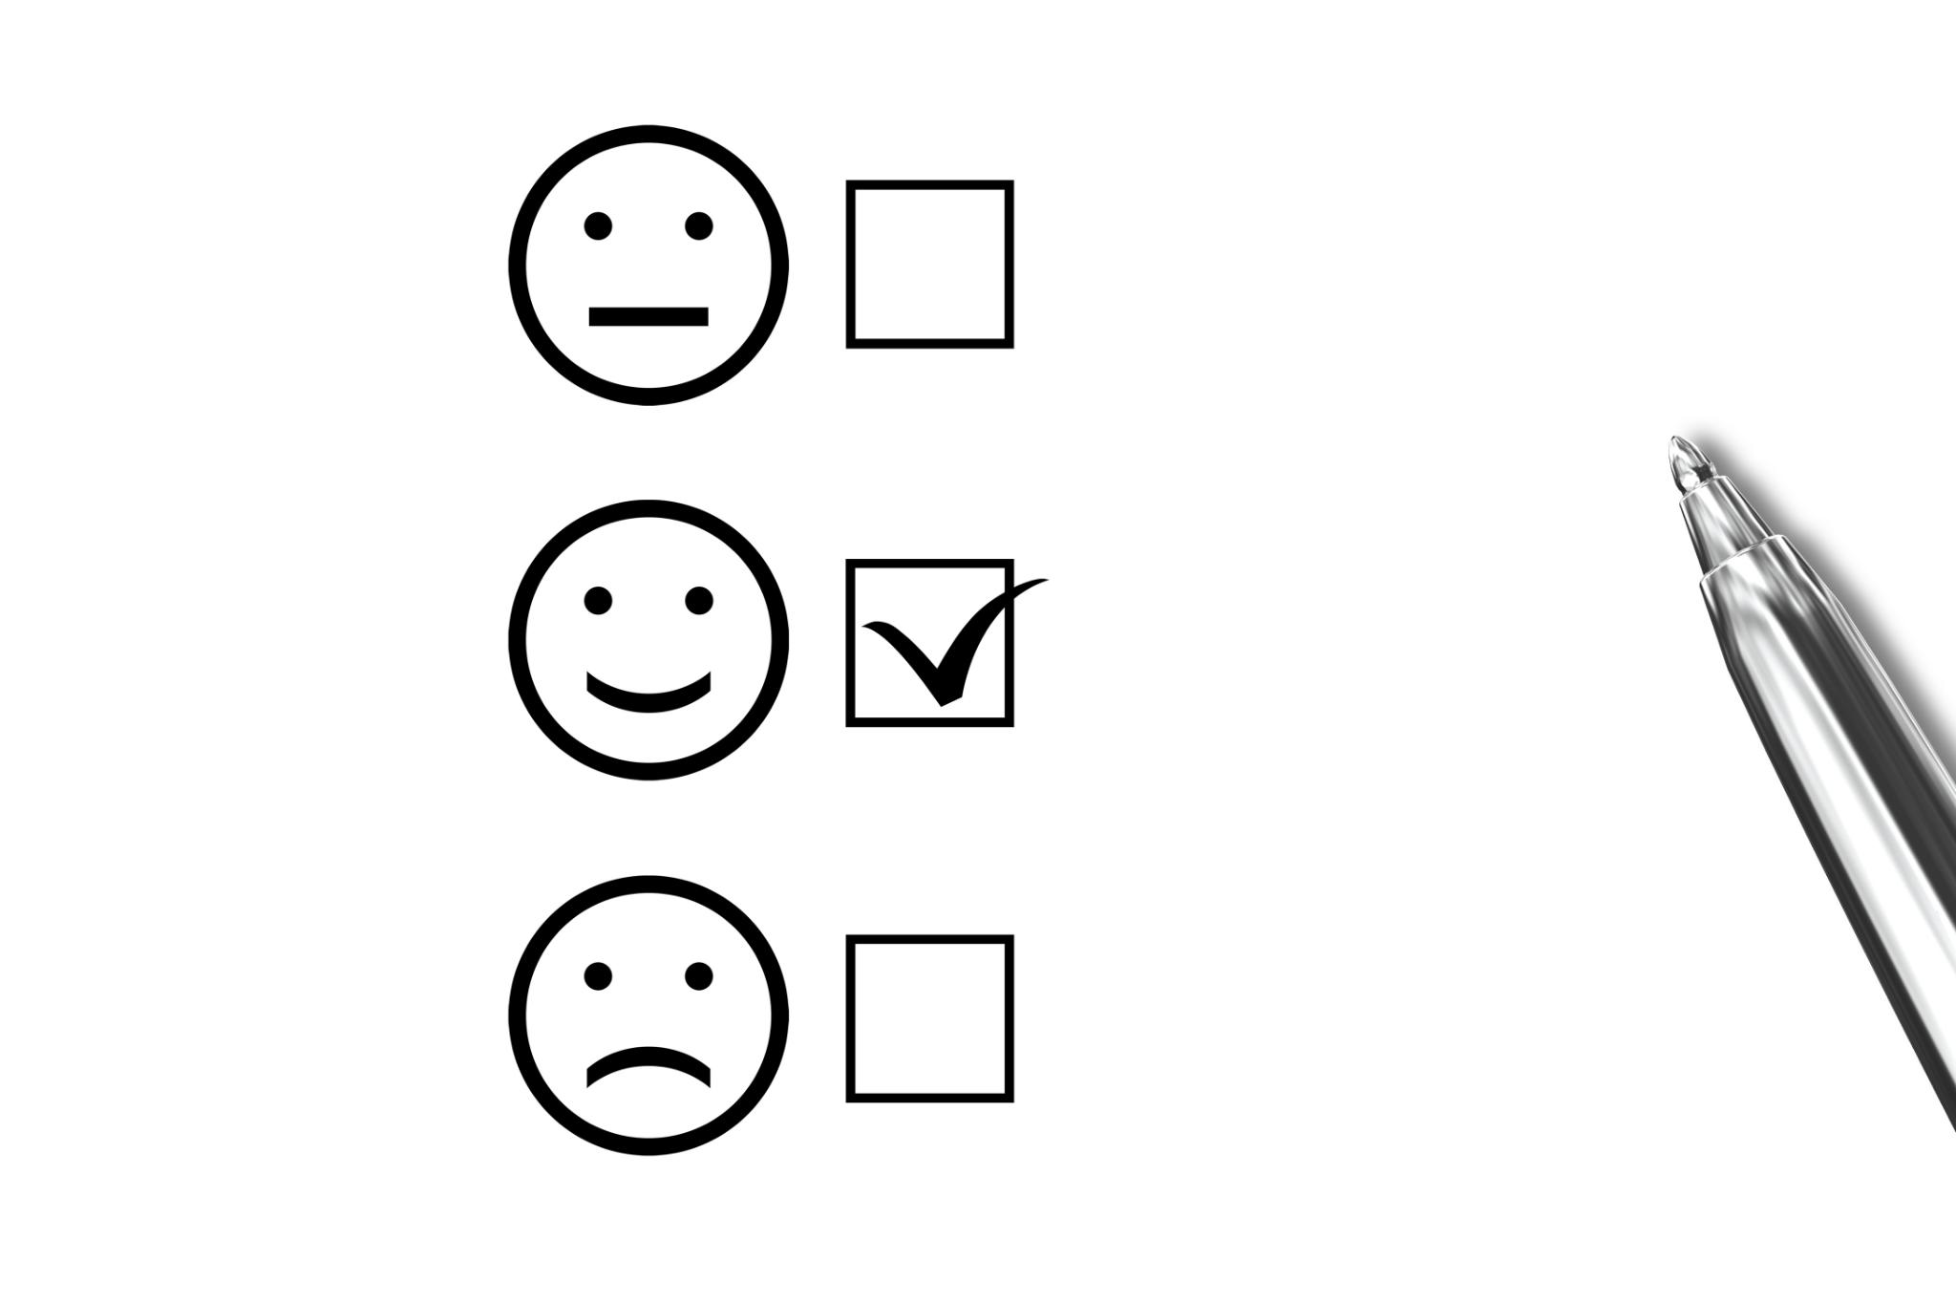
Bilingual election agendas
Translation Accuracy and Fidelity
  Maintaining legal meaning and procedural clarity is crucial across languages to avoid ambiguity and compliance issues.
AI-Powered QA Workflow
  The AI model works as a bilingual legal translator providing translation plus QA notes to flag ambiguities and review needs.
Governance and Human Oversight
  Human reviewers ensure final approval, supported by QA notes highlighting areas needing attention and consistency checks.
Standardized Prompting Conventions
  Clear role definitions, contextual inputs, and explicit guardrails help scale bilingual agenda production responsibly.
  Prompt
  Role: bilingual legal translator;
  Task: translate & QA;
  Context: election agenda;
  Guardrails: preserve meaning;
  Output: translation + QA notes
Notes:
---
This slide references information from the following file: https://aiatx-my.sharepoint.com/:p:/g/personal/damian_accountability-in-action_com/IQBsKLRm0Yl-SoRu143WK4CjAXzgQL9c1BecH9TW84RyonY,https://aiatx-my.sharepoint.com/personal/damian_accountability-in-action_com/_layouts/15/Doc.aspx?sourcedoc=%7B1063764D-44A6-44D1-9CBE-723F6835F080%7D&file=AI_Operational_Use_Cases_From_CSV%201.pptx&action=edit&mobileredirect=true,https://aiatx-my.sharepoint.com/personal/damian_accountability-in-action_com/_layouts/15/Doc.aspx?sourcedoc=%7B1DF167FD-F484-47CD-A811-CE8B24109AD1%7D&file=AB%20Austin_Prompt_Library.pptx&action=edit&mobileredirect=true&DefaultItemOpen=1
This slide addresses the operational and reputational risk involved in producing bilingual election agendas, where accuracy, legal meaning, and procedural clarity must be preserved across languages. The challenge is not simply translation fluency; it is fidelity to the source agenda’s intent, consistency with prior agenda terminology, and avoidance of introducing ambiguity that could confuse the public or create compliance issues. The AI solution proposed is a “Spanish Translation QA” workflow that positions the model as a bilingual legal translator tasked with translating and quality-assuring agendas while preserving meaning over stylistic embellishment. The prompt structure should include the full English agenda text, any known standardized terms or preferred translations (e.g., recurring sections, committee names, statutory references), and explicit guardrails requiring meaning preservation, consistent numbering, and careful handling of defined terms. The output expectation includes both the Spanish translation and QA notes that flag potentially ambiguous phrases, terms that may require human confirmation, and sections where the English source appears unclear. This dual output is important operationally: it turns translation into a controlled process with transparency about uncertainty rather than a single “final” translation that hides risk. The expected outcome is accurate Spanish agendas that maintain alignment with the English original, improving inclusivity and accessibility while reducing rework for staff who would otherwise manually spot-check line by line. Governance is reinforced by instructing the AI to avoid paraphrasing in ways that change legal meaning and to prioritize accuracy over fluency when a choice must be made. The QA notes also support attorney or bilingual reviewer oversight, providing a targeted checklist of where to focus attention. By adopting the standardized prompting conventions featured in the reference deck—clear role definition, task specificity, contextual inputs, and explicit guardrails—this use case scales bilingual agenda production responsibly. Over time, organizations can build a vetted glossary of recurring terms and feed it into prompts to further increase consistency while ensuring final approval remains with humans accountable for public-facing election materials.

Slide 20

Heavy Excel use before accounting/payroll
Spreadsheet Risks and Errors
  Spreadsheets are flexible but prone to errors like incorrect totals, misapplied rates, and inconsistent formatting under time pressure.
  AI-Powered QA Assistant
  AI assists as a quality assurance reviewer, flagging issues while preserving data integrity without editing spreadsheets.
  Benefits of AI QA
  AI-enabled QA reduces data errors, expedites reviews, ensures consistent checks, and maintains audit trails.
  Prompt
  Role: accounting ops assistant;
  Task: review spreadsheet;
  Context: pre-system data;
  Guardrails: no edits;
  Output: issues + summary
Notes:
---
This slide references information from the following file: https://aiatx-my.sharepoint.com/:p:/g/personal/damian_accountability-in-action_com/IQBsKLRm0Yl-SoRu143WK4CjAXzgQL9c1BecH9TW84RyonY,https://aiatx-my.sharepoint.com/personal/damian_accountability-in-action_com/_layouts/15/Doc.aspx?sourcedoc=%7B1063764D-44A6-44D1-9CBE-723F6835F080%7D&file=AI_Operational_Use_Cases_From_CSV%201.pptx&action=edit&mobileredirect=true,https://aiatx-my.sharepoint.com/personal/damian_accountability-in-action_com/_layouts/15/Doc.aspx?sourcedoc=%7B1DF167FD-F484-47CD-A811-CE8B24109AD1%7D&file=AB%20Austin_Prompt_Library.pptx&action=edit&mobileredirect=true&DefaultItemOpen=1
This slide highlights a common finance-operations pain point: teams often rely on complex spreadsheets before transactions are formally entered into accounting or payroll systems. While spreadsheets are flexible, they are also error-prone—especially when multiple contributors edit columns, formulas, and reference data under time pressure. The operational risk includes incorrect totals, misapplied rates, incomplete fields, and inconsistent formatting that later causes system upload failures or payroll inaccuracies. The AI use case proposed here is a “Spreadsheet QA & Summary” assistant that acts as an accounting operations reviewer. Importantly, the AI is not asked to edit the spreadsheet; it is constrained to quality assurance only, preserving data integrity and ensuring that any corrections remain deliberate human actions. The prompt should include the exported spreadsheet (or the relevant tabular contents), a description of what the sheet represents (e.g., payroll pre-processing, vendor allocation, reimbursement staging), and rules or expectations (required columns, acceptable ranges, known cross-checks such as totals matching source statements). The AI output is a structured list of issues and a summary: it can flag missing values, suspicious outliers, inconsistent date formats, duplicate entries, broken formulas, or mismatches between subtotals and totals. It can also provide a concise narrative explaining the spreadsheet’s apparent structure to help reviewers quickly orient themselves. The expected outcome is fewer data errors and smoother downstream processing, which reduces payroll disputes, vendor payment delays, and reconciliation headaches. Governance and accuracy guardrails are central: “no edits” ensures the AI cannot accidentally create a new ‘version of truth,’ and the reviewer remains responsible for approving changes. This approach mirrors the conservative constraints emphasized in the reference slide examples: AI excels at validation, pattern detection, and surfacing anomalies, but it does not replace accounting judgment. In practice, the organization benefits from faster QA cycles, more consistent checks across teams, and a documented review trail of flagged issues that can be retained for audit or internal controls purposes.

Slide 21

Manual credit-card reimbursement
Challenges of Manual Reimbursement
  Manual reconciliation involves mismatched merchant names, inconsistent receipts, and scattered invoice storage, causing delays and errors.
AI Statement–Invoice Matcher
  The AI matches card charges to receipts using conservative algorithms, marking uncertain matches and avoiding fabricated data.
Improved Efficiency and Accuracy
  The solution speeds reimbursements, reduces emails, and supports auditability by flagging missing or uncertain documents.
Human Oversight and Controls
  The AI assists organization while humans retain approval authority, ensuring governance without sacrificing accuracy.
  Prompt
  Role: admin assistant;
  Task: match charges to invoices;
  Context: AmEx statements + emails;
  Guardrails: mark low confidence;
  Output: match table
Notes:
---
This slide references information from the following file: https://aiatx-my.sharepoint.com/:p:/g/personal/damian_accountability-in-action_com/IQBsKLRm0Yl-SoRu143WK4CjAXzgQL9c1BecH9TW84RyonY,https://aiatx-my.sharepoint.com/personal/damian_accountability-in-action_com/_layouts/15/Doc.aspx?sourcedoc=%7B1063764D-44A6-44D1-9CBE-723F6835F080%7D&file=AI_Operational_Use_Cases_From_CSV%201.pptx&action=edit&mobileredirect=true,https://aiatx-my.sharepoint.com/personal/damian_accountability-in-action_com/_layouts/15/Doc.aspx?sourcedoc=%7B1DF167FD-F484-47CD-A811-CE8B24109AD1%7D&file=AB%20Austin_Prompt_Library.pptx&action=edit&mobileredirect=true&DefaultItemOpen=1
This slide addresses the administrative drag created by manual credit-card reimbursements, particularly when staff must reconcile statements, emails, and invoices across multiple sources. The challenge is that the same charge may appear with different merchant descriptors, employees may forward receipts without consistent naming, and invoices may be stored in separate systems, making matching slow and error-prone. Delays increase frustration and can lead to missed reimbursement windows or incomplete records, which impacts both employee experience and financial control. The proposed AI solution is a “Statement–Invoice Matcher,” positioned as an administrative assistant that helps match card charges to supporting documentation. The workflow relies on conservative matching: the AI inspects the provided AmEx (or other card) statements and the associated email receipts or invoice PDFs supplied by the user, then produces a match table indicating plausible pairings and explicitly marking low-confidence items. Guardrails are essential: the model should not fabricate missing invoices, should not claim access to accounting systems, and should err on the side of uncertainty when information is incomplete (for example, identical amounts across different merchants, or missing dates). The prompt should include the statement line items, the pool of receipts/invoices, and any policy constraints such as required fields or approval rules. The output is best as a table-like structure listing the statement charge, candidate invoice/receipt references, confidence notes, and flags for missing documentation. The expected outcome is faster reimbursements and fewer back-and-forth emails because staff receive an organized view of what is matched, what is missing, and what requires human clarification. From a controls perspective, conservative matching improves auditability: reviewers can see why an item was paired and where uncertainty remains. This use case aligns with the structured prompting principles from the reference deck by explicitly separating the AI’s organizational assistance from the human’s approval authority. In practice, teams can integrate the output into an internal checklist: verify high-confidence matches quickly, request missing receipts for flagged items, and document any exceptions. The result is a reliable, repeatable process that reduces clerical time without compromising governance or accuracy in expense management.

Slide 22

Candidate verification via email/LinkedIn
Challenges in Manual Verification
  Manual candidate screening is time-consuming and inconsistent, relying on scattered email, resume, and LinkedIn information.
AI Checklist Assistant
  An AI-powered checklist assistant standardizes verification without external lookups or unauthorized data access.
Verification Criteria
  Checklist verifies timelines, certifications, skills evidence, identifies gaps, and flags ambiguous claims.
Governance and Fairness
  System avoids external lookups to reduce privacy risks and ensures fair, consistent candidate evaluation.
  Prompt
  Role: admin screening assistant;
  Task: build checklist;
  Context: CV/email text;
  Guardrails: no external lookup;
  Output: checklist
Notes:
---
This slide references information from the following file: https://aiatx-my.sharepoint.com/:p:/g/personal/damian_accountability-in-action_com/IQBsKLRm0Yl-SoRu143WK4CjAXzgQL9c1BecH9TW84RyonY,https://aiatx-my.sharepoint.com/personal/damian_accountability-in-action_com/_layouts/15/Doc.aspx?sourcedoc=%7B1063764D-44A6-44D1-9CBE-723F6835F080%7D&file=AI_Operational_Use_Cases_From_CSV%201.pptx&action=edit&mobileredirect=true,https://aiatx-my.sharepoint.com/personal/damian_accountability-in-action_com/_layouts/15/Doc.aspx?sourcedoc=%7B1DF167FD-F484-47CD-A811-CE8B24109AD1%7D&file=AB%20Austin_Prompt_Library.pptx&action=edit&mobileredirect=true&DefaultItemOpen=1
This slide targets the time-consuming nature of candidate verification when screening relies on reviewing email threads, resumes, and snippets of LinkedIn-provided text manually. The operational challenge is that reviewers want consistent screening standards—verifying key credentials, employment history claims, and potential red flags—without inadvertently overstepping by doing external lookups or making unsupported assertions. The AI use case is a “Candidate Verification Checklist” assistant, positioned as an administrative screening support tool. The model is explicitly constrained: it should not perform external lookup, should not claim access to LinkedIn or third-party data, and should output a checklist only based on the information provided. The prompt should include whatever text the organization has legitimately received: a resume, candidate email responses, or pasted profile text, along with role requirements such as required certifications, years of experience, and mandatory background checks. The AI produces a structured checklist that standardizes verification activities: confirm timeline consistency across documents; validate that claimed certifications include issuing body and dates; ensure required skills are evidenced in work examples; identify gaps that require follow-up questions; and flag ambiguous claims (e.g., “led projects” without scope). The expected outcome is faster screening and improved consistency across screeners, because the checklist anchors everyone to the same verification steps rather than ad hoc judgment. Governance benefits are strong: by explicitly avoiding external lookup and focusing on “what to verify” rather than “what is true,” the tool reduces privacy risk and helps ensure that decisions remain grounded in verified processes. This approach mirrors the conservative, operational use-case style in the reference presentation: the AI supports organization and process discipline, but hiring decisions and factual verification remain with humans. In practice, the checklist can be integrated into existing HR workflows, ensuring that candidates are evaluated fairly and that follow-up questions are targeted to specific gaps rather than generic requests. Over time, teams can refine the checklist prompts to match different roles while maintaining the core guardrails that prevent speculative or unauthorized verification behaviors.

Slide 23

Identifying repetitive discovery tasks
Challenge of Task Identification
  Litigation discovery involves repetitive tasks but distinguishing AI-eligible tasks is complex and requires careful judgment.
Litigation Task Discovery Use Case
  AI extracts and lists recurring discovery tasks from transcripts and notes without inventing or inferring unsupported tasks.
Structured Prompting and Guardrails
  Use role, task, context, guardrails, and output to ensure AI transparency and human oversight in task discovery.
Outcome and Governance
  Clear task lists enable prioritization and responsible AI adoption, maintaining human accountability and reducing risk.
  Prompt
  Role: litigation ops assistant;
  Task: extract tasks;
  Context: discovery transcript;
  Guardrails: no invention;
  Output: task list
Notes:
---
This slide references information from the following file: https://aiatx-my.sharepoint.com/:p:/g/personal/damian_accountability-in-action_com/IQBsKLRm0Yl-SoRu143WK4CjAXzgQL9c1BecH9TW84RyonY,https://aiatx-my.sharepoint.com/personal/damian_accountability-in-action_com/_layouts/15/Doc.aspx?sourcedoc=%7B1063764D-44A6-44D1-9CBE-723F6835F080%7D&file=AI_Operational_Use_Cases_From_CSV%201.pptx&action=edit&mobileredirect=true,https://aiatx-my.sharepoint.com/personal/damian_accountability-in-action_com/_layouts/15/Doc.aspx?sourcedoc=%7B1DF167FD-F484-47CD-A811-CE8B24109AD1%7D&file=AB%20Austin_Prompt_Library.pptx&action=edit&mobileredirect=true&DefaultItemOpen=1
This slide addresses the litigation operations challenge of identifying repetitive discovery tasks that are suitable for responsible AI assistance. Discovery workflows often include repeated steps—extracting requests, mapping custodians, summarizing production status, drafting templated communications—but teams may struggle to separate AI-eligible tasks from those requiring attorney judgment. The proposed AI use case is “Litigation Task Discovery,” which positions the model as a litigation operations assistant tasked with extracting and listing recurring tasks from a discovery transcript, meeting notes, or workflow description. The guardrail is explicit: the AI must not invent tasks, infer unstated requirements, or propose automation that the source material does not support. Instead, it should perform disciplined extraction, providing clarity and structure for human decision-makers. The prompt should include the relevant source text: discovery planning notes, deposition preparation checklists, case management meeting minutes, or any narrative that describes what people are doing repeatedly. The output is a task list—ideally grouped by phase (collection, review, production, privilege, tracking, communications)—and may include frequency indicators if the source material suggests repetition. The expected outcome is a clear AI-eligible task list that enables leadership to prioritize which processes to standardize, template, or support with prompts, without prematurely committing to automation. Governance is maintained because this use case is upstream and diagnostic: it helps teams understand their work, not replace it. The slide’s framing emphasizes that AI performs best when given structured, bounded problems, and that “task discovery” is a safe starting point because it produces transparency rather than legal conclusions. By aligning with standardized prompting—role, task, context, guardrails, output—the organization can create repeatable task inventories across matters and departments. In practice, once tasks are surfaced, attorneys and operations leaders can decide where AI can assist (e.g., summarization, drafting, extraction) and where it should not (e.g., privilege determinations, strategic arguments). The result is faster adoption with reduced risk: teams focus on real operational friction points, maintain human accountability, and build a roadmap for responsible AI support in discovery operations.

Slide 24

Uncertainty about AI capabilities
Adoption Barrier: AI Uncertainty
  Teams face uncertainty about AI's safe and effective use in workflows, risking underuse or overtrust.
Prompt Pattern Library Solution
  A curated library provides standardized prompt examples tied to pain points, accelerating safe AI adoption.
Governance and Guardrails
  Embedded guardrails ensure prompts emphasize human review and prevent unauthorized AI actions.
Operational Benefits
  Reduces cognitive load and promotes consistency, enabling repeatable and responsible AI prompting.
  Prompt
  Role: litigation support assistant;
  Task: propose prompts;
  Context: stated pain points;
  Guardrails: no automation promises;
  Output: prompt examples
Notes:
---
This slide references information from the following file: https://aiatx-my.sharepoint.com/:p:/g/personal/damian_accountability-in-action_com/IQBsKLRm0Yl-SoRu143WK4CjAXzgQL9c1BecH9TW84RyonY,https://aiatx-my.sharepoint.com/personal/damian_accountability-in-action_com/_layouts/15/Doc.aspx?sourcedoc=%7B1063764D-44A6-44D1-9CBE-723F6835F080%7D&file=AI_Operational_Use_Cases_From_CSV%201.pptx&action=edit&mobileredirect=true,https://aiatx-my.sharepoint.com/personal/damian_accountability-in-action_com/_layouts/15/Doc.aspx?sourcedoc=%7B1DF167FD-F484-47CD-A811-CE8B24109AD1%7D&file=AB%20Austin_Prompt_Library.pptx&action=edit&mobileredirect=true&DefaultItemOpen=1
This slide addresses a foundational adoption barrier: professional teams often experience uncertainty about what AI can do safely and effectively in their specific workflows. Without concrete examples and shared patterns, staff may either underuse AI (missing productivity gains) or overtrust it (creating governance risk). The proposed solution is a “Prompt Pattern Library (Litigation)” use case designed to accelerate adoption through curated, standardized prompt examples tied directly to stated pain points. The AI is positioned as a litigation support assistant whose task is to propose prompts—not to perform automated actions or promise outcomes beyond what the organization can verify. Guardrails are crucial: the assistant should avoid claims that it can access systems, retrieve privileged materials without oversight, or replace legal judgment. Instead, it should produce examples only, emphasizing human review and verification. The prompt inputs should include the team’s described pain points (e.g., drafting routine discovery correspondence, summarizing transcripts, extracting deadlines, structuring notes) plus any style or compliance requirements, such as confidentiality constraints and citation rules. The output is a set of ready-to-use prompt templates following a standardized structure: role, task, context, inputs required, constraints, and output formatting. This approach yields two major operational benefits. First, it reduces cognitive load: users don’t need to invent prompts from scratch; they select and adapt vetted patterns. Second, it promotes governance and consistency by embedding guardrails into the template library, ensuring responsible usage across staff and matters. The expected outcome is faster adoption and more predictable results because the organization moves from improvisation to repeatable prompting practices. The slide should also communicate that a prompt library is a living asset: teams test, refine, and curate prompts based on performance and risk feedback. By aligning with the standardized prompting framework illustrated in the reference deck, this use case treats prompting as an operational discipline rather than a casual chat. In practice, rolling out a prompt pattern library can be combined with short training sessions, example demonstrations, and a lightweight review process so that prompts used in regulated or legal environments remain conservative, source-bound when needed, and explicitly human-reviewed before any external or formal use.

Slide 25
Lease drafting from unstructured LOIs
Challenges of Unstructured LOIs
Critical lease terms are scattered or inconsistently worded in unstructured LOIs, complicating manual extraction.
AI Lease Structuring Solution
AI extracts terms from LOIs into a standardized lease template, flagging ambiguities and missing values without guessing.
Benefits of AI Assistance
AI accelerates lease drafting, improves governance by surfacing ambiguities, and supports consistent, scalable workflows.
Prompt
Role: leasing assistant;
Task: extract terms;
Context: unstructured LOI;
Guardrails: flag ambiguities;
Output: populated lease
Notes:
---
This slide references information from the following file: https://aiatx-my.sharepoint.com/:p:/g/personal/damian_accountability-in-action_com/IQBsKLRm0Yl-SoRu143WK4CjAXzgQL9c1BecH9TW84RyonY,https://aiatx-my.sharepoint.com/personal/damian_accountability-in-action_com/_layouts/15/Doc.aspx?sourcedoc=%7B1063764D-44A6-44D1-9CBE-723F6835F080%7D&file=AI_Operational_Use_Cases_From_CSV%201.pptx&action=edit&mobileredirect=true,https://aiatx-my.sharepoint.com/personal/damian_accountability-in-action_com/_layouts/15/Doc.aspx?sourcedoc=%7B1DF167FD-F484-47CD-A811-CE8B24109AD1%7D&file=AB%20Austin_Prompt_Library.pptx&action=edit&mobileredirect=true&DefaultItemOpen=1
This slide focuses on the friction created when lease drafting begins from unstructured letters of intent (LOIs), emails, or loosely formatted term sheets. The challenge is that critical lease terms—rent schedules, renewal rights, operating expenses, exclusives, delivery conditions, and remedies—may be scattered across narrative text, embedded in inconsistent wording, or partially missing. Manual extraction is time-consuming and increases the risk that important terms are overlooked or inconsistently translated into the lease form. The proposed AI use case is “LOI → Lease Structurer,” positioning the model as a leasing assistant tasked with extracting terms and populating a structured lease template while explicitly flagging ambiguities. The key operational principle is structure-first: the AI should convert unstructured inputs into a standardized term map, identify gaps, and avoid inferring missing values. The prompt should include the LOI text and, where available, the target lease template or at least the list of required lease sections. Guardrails require the AI to mark ambiguities, highlight conflicting terms, and avoid presenting guesses as facts. For example, if the LOI references “standard CAM” without defining the standard, the AI should flag it as undefined rather than inventing a definition. The output expectation is a populated lease structure (or term sheet) that mirrors the lease document’s organization, along with a list of missing items and questions for follow-up. The expected outcome is faster lease drafts because legal teams begin with a structured draft rather than a blank template and a pile of emails. Governance and defensibility improve because ambiguities are surfaced, not hidden—supporting better negotiation management and more accurate drafting. This mirrors the compliant prompting style in the reference deck: role and task clarity, explicit boundaries around inference, and output format requirements that make the result operationally usable. In practice, attorneys still review the draft language, ensure compliance with jurisdictional requirements, and apply firm-specific drafting standards. But the AI significantly reduces the front-end labor of organizing and mapping terms. Over time, teams can build standardized prompts for different lease types (retail, office, industrial) and maintain a consistent extraction method, making the drafting pipeline more predictable and scalable while retaining human control over final deal positions.

Slide 26

Tracking critical contract dates
Operational Risk of Missing Dates
  Missing contract deadlines causes lost rights and compliance failures due to manual tracking complexities.
AI Critical Dates Extractor
  AI assists by extracting and summarizing critical dates into tables for human verification, avoiding auto-calendar errors.
Human Verification Requirement
  Human review ensures accuracy, especially for relative dates, business days, and jurisdiction rules.
Improved Coordination and Compliance
  Structured date summaries enhance team coordination and reduce administrative burden without uncontrolled automation.
  Prompt
  Role: transaction coordinator;
  Task: extract dates;
  Context: relative timelines;
  Guardrails: no auto-calendar;
  Output: dates table
Notes:
---
This slide references information from the following file: https://aiatx-my.sharepoint.com/:p:/g/personal/damian_accountability-in-action_com/IQBsKLRm0Yl-SoRu143WK4CjAXzgQL9c1BecH9TW84RyonY,https://aiatx-my.sharepoint.com/personal/damian_accountability-in-action_com/_layouts/15/Doc.aspx?sourcedoc=%7B1063764D-44A6-44D1-9CBE-723F6835F080%7D&file=AI_Operational_Use_Cases_From_CSV%201.pptx&action=edit&mobileredirect=true,https://aiatx-my.sharepoint.com/personal/damian_accountability-in-action_com/_layouts/15/Doc.aspx?sourcedoc=%7B1DF167FD-F484-47CD-A811-CE8B24109AD1%7D&file=AB%20Austin_Prompt_Library.pptx&action=edit&mobileredirect=true&DefaultItemOpen=1
This slide addresses the operational risk of missing critical contract dates—notice periods, renewal windows, option exercise deadlines, milestone deliverables, and termination triggers—especially when timelines are expressed in relative terms (e.g., “within 30 days of execution” or “no later than 10 business days after receipt”). The manual process of reading agreements, extracting timelines, and reconciling relative dates with execution dates is time-intensive and prone to oversight, which can lead to lost rights, late notices, or compliance failures. The proposed AI use case is a “Critical Dates Extractor,” positioned as a transaction coordinator assistant that extracts and summarizes dates into a table for human verification. The guardrail is explicit: the AI should not auto-calendar events, should not assume unknown base dates, and should label items that require human confirmation. The prompt should include the contract text (or relevant sections), any known anchor facts (execution date, effective date), and instructions on the desired output format. The AI output should list each critical date obligation with the triggering event, the relative rule, any computed date (only when anchor data is provided), and a verification flag reminding the reviewer to confirm accuracy. The expected outcome is clearer date summaries and more reliable coordination across teams because stakeholders gain a single, structured view of obligations rather than scattered references across documents. Governance is enhanced by keeping the process “human verification required” and treating AI computations as draft suggestions, particularly when business day calculations, holidays, or jurisdiction-specific rules apply. This slide’s narrative should emphasize that AI’s value lies in rapid extraction and organization: it can scan for date-related language, standardize phrasing, and surface deadlines that might otherwise be missed. The output then becomes a practical working artifact for a transaction checklist or project tracker. By adopting the standardized prompting conventions demonstrated in the reference deck, teams minimize hallucination risk and improve repeatability. In practice, legal and operations staff review the extracted list, confirm dates, and then enter them into the appropriate calendaring or contract lifecycle management systems. This approach reduces administrative burden and improves compliance posture without introducing uncontrolled automation.

Slide 27
Loan document packs
Complexity of Loan Documents
  Loan document packs involve assembling multiple interrelated legal documents with consistent base terms.
AI-Assisted Drafting
  AI builds drafts one document at a time to reduce errors and enable human review between stages.
Governance and Oversight
  Human oversight ensures legal accuracy and compliance, preventing AI from inventing missing facts.
Operational Benefits
  The AI accelerates drafting, reduces manual copying, and allows focus on risk analysis and negotiation.
  Prompt
  Role: real-estate finance assistant;
  Task: generate docs;
  Context: base terms;
  Guardrails: one doc at a time;
  Output: drafts
Notes:
---
This slide references information from the following file: https://aiatx-my.sharepoint.com/:p:/g/personal/damian_accountability-in-action_com/IQBsKLRm0Yl-SoRu143WK4CjAXzgQL9c1BecH9TW84RyonY,https://aiatx-my.sharepoint.com/personal/damian_accountability-in-action_com/_layouts/15/Doc.aspx?sourcedoc=%7B1063764D-44A6-44D1-9CBE-723F6835F080%7D&file=AI_Operational_Use_Cases_From_CSV%201.pptx&action=edit&mobileredirect=true,https://aiatx-my.sharepoint.com/personal/damian_accountability-in-action_com/_layouts/15/Doc.aspx?sourcedoc=%7B1DF167FD-F484-47CD-A811-CE8B24109AD1%7D&file=AB%20Austin_Prompt_Library.pptx&action=edit&mobileredirect=true&DefaultItemOpen=1
This slide covers the complexity of producing loan document packs, a workflow that requires assembling multiple interrelated documents—notes, deeds of trust, guarantees, security agreements, closing certificates—based on a shared set of base terms. The manual process often involves copying prior forms, updating deal-specific variables, and ensuring consistency across documents, which is time-consuming and can produce clerical errors when terms change or when multiple contributors work in parallel. The proposed AI use case is a “Loan Document Pack Builder,” positioning the model as a real-estate finance assistant tasked with generating drafts based on provided base terms, with a governance guardrail that documents are generated one at a time. This constraint is significant: it reduces cascade errors and allows human review between documents, ensuring that key variables (borrower name, principal amount, interest terms, maturity date, collateral description) remain consistent and accurately reflected. The prompt should include a clearly enumerated set of base terms and, ideally, the document form or preferred clause library. The assistant then drafts the requested document and highlights any missing inputs or ambiguous terms that must be confirmed (for example, whether the loan is recourse, what events of default apply, or how amendments are handled). The expected operational benefit is faster drafting of loan documents with reduced manual copying, enabling attorneys and paralegals to spend more time on deal-specific risk analysis and negotiation rather than repetitive assembly. Governance is reinforced by preventing the AI from inventing missing deal facts and requiring human oversight for each document. The slide should emphasize that this is a drafting accelerator, not an autonomous document engine: humans remain responsible for legal correctness, jurisdictional compliance, and final deliverables. Aligning with the standardized prompting framework in the reference deck, the prompt should define role, task, context, guardrails, and output format, ensuring consistent results. In practice, teams can implement a controlled pipeline: generate the note draft, verify terms; generate the security instrument, verify collateral; and so on, maintaining a systematic review process. This provides predictable efficiency gains while preserving accountability and reducing error risk across complex loan documentation packages.

Slide 28
Manual signature blocks
Challenges of Manual Signature Blocks
  Manual signature block preparation is error-prone and causes delays due to exact entity and authority details needed.
AI Signature Block Generator
  AI assists by generating standardized signature blocks based on explicit entity data with strict guardrails to avoid errors.
Verification Checklist Importance
  A checklist ensures repeatable review, catching issues like mismatched names or missing authority language.
Benefits of AI Standardization
  AI improves consistency, reduces clerical errors, and speeds document turnaround while preserving human accountability.
  Prompt
  Role: legal admin assistant;
  Task: generate blocks;
  Context: entity data;
  Guardrails: no authority assumptions;
  Output: blocks + checklist
Notes:
---
This slide references information from the following file: https://aiatx-my.sharepoint.com/:p:/g/personal/damian_accountability-in-action_com/IQBsKLRm0Yl-SoRu143WK4CjAXzgQL9c1BecH9TW84RyonY,https://aiatx-my.sharepoint.com/personal/damian_accountability-in-action_com/_layouts/15/Doc.aspx?sourcedoc=%7B1063764D-44A6-44D1-9CBE-723F6835F080%7D&file=AI_Operational_Use_Cases_From_CSV%201.pptx&action=edit&mobileredirect=true,https://aiatx-my.sharepoint.com/personal/damian_accountability-in-action_com/_layouts/15/Doc.aspx?sourcedoc=%7B1DF167FD-F484-47CD-A811-CE8B24109AD1%7D&file=AB%20Austin_Prompt_Library.pptx&action=edit&mobileredirect=true&DefaultItemOpen=1
This slide addresses a deceptively costly clerical task: creating and maintaining accurate signature blocks across contracts, resolutions, and closing documents. Manual signature block preparation is error-prone because entity names, jurisdictions, titles, and authority lines must be exact; small mistakes can cause execution delays, require re-signing, or create interpretive disputes later. The proposed AI solution is a “Signature Block Generator,” positioned as a legal administrative assistant. The prompt should provide the entity data explicitly—legal entity name, entity type, state of formation, signatory name and title, and any known authority requirements—while imposing strict guardrails: the AI must make no authority assumptions, must not invent missing titles or capacities, and should provide both the signature block text and a checklist of items to verify. This checklist is a key governance feature because it creates a repeatable review step that catches common issues such as mismatched legal names, missing capacity language, incorrect DBA usage, or inconsistent formatting across parties. The expected outcome is fewer clerical errors and faster document turnaround, particularly in transactions where many documents require consistent signature formatting. The slide narrative should reinforce that the AI’s value is standardization and consistency: it can apply a firm’s formatting conventions reliably while ensuring the output remains grounded in provided entity facts. If information is missing, the AI should mark it clearly (e.g., “TBD”) rather than guessing. This approach aligns with the conservative prompting style in the reference deck, which emphasizes strict boundaries and human review reminders. In practice, legal ops teams can maintain approved signature block templates for common entity types and provide those as context, further reducing variability. Attorneys or transaction coordinators then validate the signatory’s authority and ensure compliance with internal and external requirements. By combining AI-generated drafts with a structured verification checklist, organizations reduce repetitive work without compromising the integrity of executed documents, keeping accountability where it belongs while improving operational efficiency.

Slide 29

Finding variations across prior contracts
Manual Contract Comparison Challenges
  Manually comparing contracts is slow, error-prone, and requires detailed review of clauses and structure.
AI-Powered Variation Analysis
  The AI Contract Variation Analyzer creates neutral tables showing differences without ranking or legal advice.
Improved Precedent and Negotiation Support
  Variation tables allow attorneys to quickly identify key differences and focus on legal judgment and negotiation.
Governance and Human Oversight
  AI outputs remain source-bound and neutral, requiring human review to ensure legal accuracy and accountability.
  Prompt
  Role: contract analysis assistant;
  Task: compare contracts;
  Context: past agreements;
  Guardrails: no ranking;
  Output: variation table
Notes:
---
This slide references information from the following file: https://aiatx-my.sharepoint.com/:p:/g/personal/damian_accountability-in-action_com/IQBsKLRm0Yl-SoRu143WK4CjAXzgQL9c1BecH9TW84RyonY,https://aiatx-my.sharepoint.com/personal/damian_accountability-in-action_com/_layouts/15/Doc.aspx?sourcedoc=%7B1063764D-44A6-44D1-9CBE-723F6835F080%7D&file=AI_Operational_Use_Cases_From_CSV%201.pptx&action=edit&mobileredirect=true,https://aiatx-my.sharepoint.com/personal/damian_accountability-in-action_com/_layouts/15/Doc.aspx?sourcedoc=%7B1DF167FD-F484-47CD-A811-CE8B24109AD1%7D&file=AB%20Austin_Prompt_Library.pptx&action=edit&mobileredirect=true&DefaultItemOpen=1
This slide focuses on the labor-intensive work of identifying variations across prior contracts to support precedent selection, negotiation strategy, and risk evaluation. Manually comparing multiple agreements requires careful attention to clause language, defined terms, structure, and exceptions—often across dozens of pages—making it slow and prone to missed differences. The proposed AI use case is a “Contract Variation Analyzer,” positioning the model as a contract analysis assistant tasked with comparing contracts and producing a neutral variation table. The guardrail is central: the AI must not rank clauses, recommend positions, or provide legal conclusions; it should perform comparison only, leaving substantive judgment to attorneys. The prompt should include the set of agreements to compare and specify which sections matter most (e.g., indemnity, limitation of liability, termination, assignment, confidentiality). The assistant then outputs an organized table of differences, capturing where language diverges, noting additions or deletions, and summarizing structural variance (such as different notice requirements or dispute resolution forums). The expected outcome is faster precedent analysis because attorneys can spot key differences quickly and focus their time on evaluating which version is acceptable for a given deal rather than spending hours on mechanical comparison. Governance is maintained by requiring the analysis to be source-bound: the AI should quote or reference the relevant clause language and avoid inventing explanations for why changes exist. Human review remains essential because even small wording changes can materially alter risk. This use case mirrors the reference presentation’s operational examples that emphasize neutral outputs and human decision-making, such as comparisons without ranking and strict guardrails against interpretation. In practice, teams can use the variation table as a working artifact during negotiation: it supports discussions about preferred language, helps identify the most protective precedent, and documents rationale for deviations. Over time, organizations can build internal playbooks by tagging common clause variants and correlating them with outcomes, but the initial step—rapid, neutral variance detection—delivers immediate productivity gains while respecting legal accountability and governance requirements.

